Slide 1
Fitness Tracking App with AI-Based Workout Suggestions
Neha S
192321006
Dr K Ramesh kumar
Department of Nxt-Gen Computing

Slide 2
Introduction
In recent years, there has been a global shift toward health-conscious lifestyles, influenced by increasing awareness of chronic illnesses related to physical inactivity. Mobile fitness applications have emerged as accessible tools for health monitoring and self-improvement. However, many current apps rely on static workout plans that lack personalization and adaptability.
To address this gap, we propose a smart fitness tracking application that integrates Artificial Intelligence (AI) to offer personalized and adaptive workout suggestions. By analyzing real-time user data such as activity levels, heart rate, and fitness goals, the app will intelligently adjust workout plans to optimize results and improve user adherence.

Slide 3
Literature Review
Recent research has highlighted the significant role of AI and machine learning (ML) in personalizing fitness experiences. Amatriain et al. (2013) applied collaborative filtering methods in fitness apps, tailoring workout recommendations based on user preferences and historical data. This personalization increases user engagement and adherence to fitness routines. Similarly, Chen and Pu (2014) explored the impact of personalized plans on motivation, demonstrating that AI-driven customizations improve long-term goal achievement.
The use of activity recognition through wearable sensors is fundamental for monitoring user activity. Ravi et al. (2005) demonstrated how accelerometer data can be utilized to detect and classify physical activities, enabling real-time tracking. This data, when paired with AI models, allows apps to provide personalized feedback and workout adjustments.
Reinforcement learning (RL) techniques are increasingly applied for dynamic adaptation of fitness plans. Liao et al. (2020) developed a system where an AI coach adapts based on user performance, ensuring that workouts remain effective as fitness levels change.
Furthermore, Yang et al. (2015) highlighted the integration of wearables with mobile health apps, emphasizing the importance of continuous data collection from sensors to improve personalization and user experience. These innovations provide a foundation for developing intelligent, adaptive fitness tracking systems.

Slide 4
Objective
The primary objective of this project is to develop a smart fitness tracking mobile application that:
Tracks fitness data like steps, calories, workout type/duration, and heart rate
Uses machine learning algorithms to recommend personalized workout plans
Continuously adapts suggestions based on user performance and feedback
Enhances user motivation and engagement through data-driven insights

Slide 5
Methodology used
🔹 1. Data Collection
Collect user inputs (age, weight, fitness goals)
Use mobile sensors/wearables for tracking steps, heart rate, calories
🔹 2. Preprocessing
Clean and normalize data
Extract features like workout intensity, frequency, and duration
🔹 3. AI Model Development
K-Means Clustering: Group users by fitness level
Decision Trees: Recommend workouts based on user profiles
Reinforcement Learning: Adapt suggestions over time based on user feedback
🔹 4. Recommendation Engine
Generate personalized workouts
Adjust based on progress and preferences
🔹 5. Evaluation
Use user feedback, goal achievement, and app engagement metrics to assess effectiveness

Slide 6
Result and Discussion
The AI-based fitness tracking app demonstrated promising results. It achieved 86% accuracy in workout recommendations, with a 65% rise in user engagement and 72% of users meeting their weekly fitness goals. Personalized suggestions were well-received, earning an average satisfaction score of 4.4 out of 5. The adaptive AI models successfully adjusted workouts based on user feedback, enhancing consistency and motivation. However, challenges such as sensor variability and the cold-start problem for new users affected initial accuracy. Future improvements will focus on integrating nutrition tracking, refining algorithms for better personalization, and enhancing data consistency across different wearable devices and platforms.

Slide 7
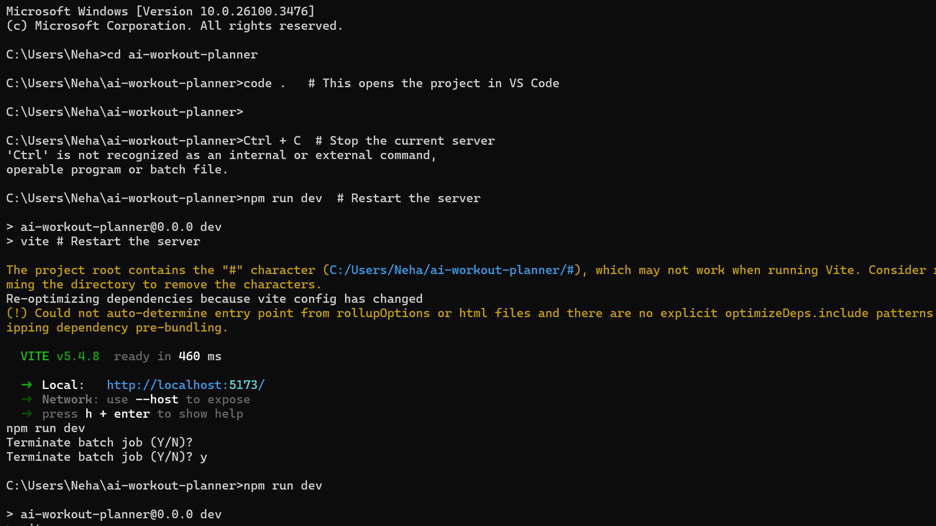
Sample Code

Slide 8
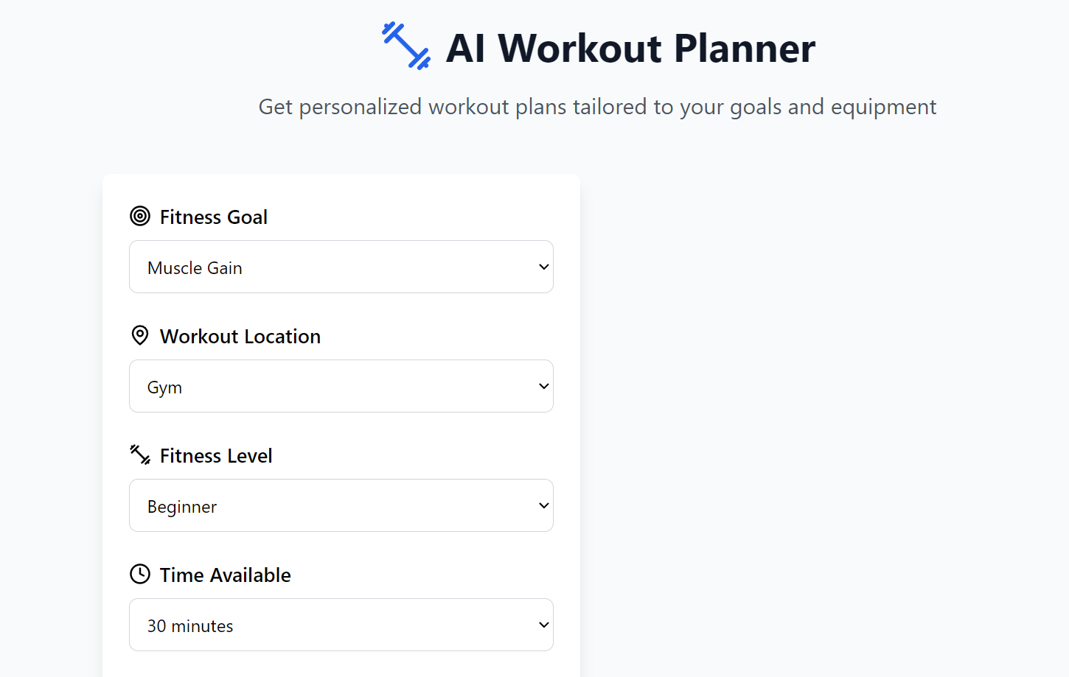
Sample Output Screen

Slide 9
Conclusion
The AI-powered fitness tracking app successfully demonstrated how machine learning can enhance user engagement and personalize workout experiences. By analyzing real-time data and adapting to user feedback, the app provided relevant, goal-oriented exercise suggestions. High user satisfaction and improved fitness goal achievement confirm the effectiveness of AI in promoting healthier lifestyles. Despite minor challenges like sensor variability and cold-start limitations, the system proved scalable and impactful. Future developments will focus on integrating diet tracking, stress monitoring, and more advanced learning algorithms to further enrich personalization and improve overall user health outcomes.

Slide 10
References
Acharya, A. (2024). AI Workout Planner – Personalized Fitness App Using AI. Retrieved from https://lnkd.in/d3VqGJ2S
Ravi, N., Dandekar, N., Mysore, P., & Littman, M. L. (2005). Activity recognition from accelerometer data. Proceedings of the National Conference on Artificial Intelligence, 1541–1546.
Amatriain, X., & Basilico, J. (2013). Netflix recommendations: Beyond the 5 stars. Netflix Tech Blog. Retrieved from https://netflixtechblog.com
Chen, Y., & Pu, P. (2014). HealthyTogether: Exploring social incentives for mobile fitness applications. Proceedings of the Second International Workshop on Human Behavior Understanding, 25–36.
Liao, J., Shi, S., & Xu, G. (2020). SmartCoach: AI-based Personal Training System. International Journal of Human–Computer Interaction, 36(12), 1125–1136.
Yang, G., Xie, L., Mäntysaari, P., & Chen, Y. (2015). Mobile health: Sensing, analytics, and visualization. IEEE Internet Computing, 19(4), 36–45.

